Slide 1
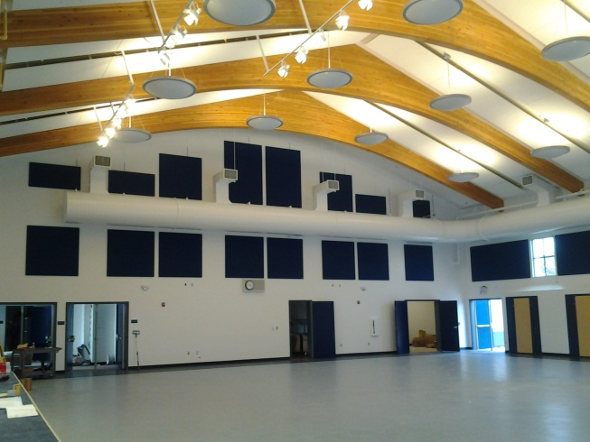
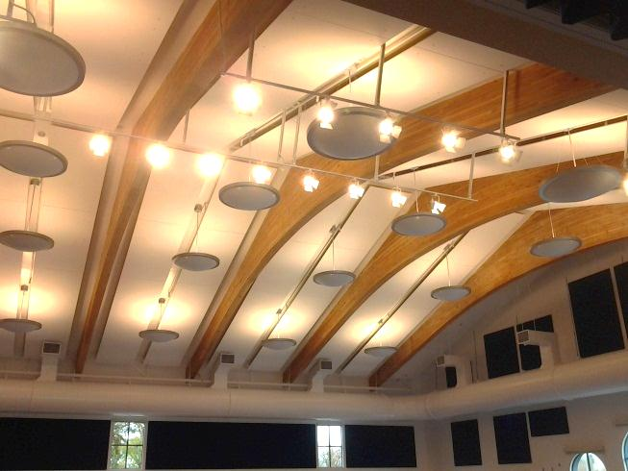
PROJECT SUMMARY
Rucker Elementary School
CECI Project # | 208470
Project Address | 325 Santa Clara Avenue, Gilroy, CA 95020
Date of Completion | 9/30/2014 | Duration | 21 Month Project
Size | 12,141 Square Feet | Contract | $1,125,901.00
Description | New community center, multi-purpose room with a full kitchen.
Owner | Gilroy Unified School District 7810 Arroyo Circle, Gilroy, CA 95020 Michael Rice; 408-847-842-5317; mike.rice@gilroyunified.org
General Contractor | Seeward L. Schreder Construction, Inc. 1855 Buenaventura Boulevard, Redding, CA 96001 Mike Smull; 530-521-4775; mike@slsconst.com General Contractor’s Project #
Architect | Alan Kroeker of PMSM Architects
Engineer | Thoma Electric 3562 Empleo Street, San Luis Obispo, CA 93401 Jimmy Dean; 805-543-3850
STATE LICENSE #115427
MEMBER OF

